Slide 1
Unplugged CT Puzzles
Notes:
A lot of the experience of solving these problems works best in collaborative approaches. 2 or 3 per group.

Slide 2
Unplugged CT Puzzles
The level of difficulty
is (generally) graded from
Beginner to Advanced
Notes:
Students should be encouraged to use CT skills such as Abstraction, Algorithmic Thinking, Logical thinking (even heuristics for some more difficult problems), Data representation using grids or graphs for example, Decomposition, Evaluation, Pattern Recognition, Generalisation and most of all try to be Creative.

Slide 3
Unplugged CT Puzzles
What is important is thinking about how you solve the puzzles.
Is there a systematic method for solving problems?
LO 1.1 students should be able to describe a systematic process for solving problems and making decisions
Notes:
Students should be encouraged to use CT skills such as Abstraction, Algorithmic Thinking, Logical thinking (even heuristics for some more difficult problems), Data representation using grids or graphs for example, Decomposition, Evaluation, Pattern Recognition, Generalisation and most of all try to be Creative.

Slide 4

Bebras Challenge
Many of the puzzles are inspired by Bebras Challenges
Supports Computational Thinking
National Competition Each Year
Lets start……..

Slide 5
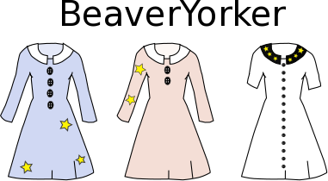
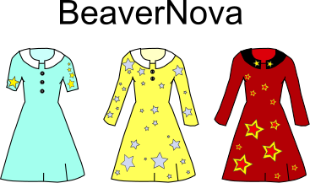
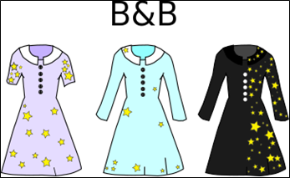
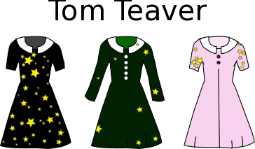
Dream Dress
Kate wants to buy her dream dress. It must
have short sleeves, and
have more than 3 buttons, and
have stars on its sleeves.
Four shops sell only the dresses shown.
A: BeaverYorker B: BeaverNova C:B & B D:Tom Teaver

Slide 6
Dream Dress: Answer
Answer: The answer is C => B&B
Explanation:
To solve this task, one must simultaneously satisfy three requirements. This can be done by discarding coats that do not meet any one of the requirements. After doing this, one can see that the dress on the bottom left sold by B&B is Kate's dream dress.
The other answers are incorrect because:
The only dress sold by BeaverYorker with stars on the sleeves has long sleeves;
Beaver Nova does not sell any coats with more than three buttons;
The only dress sold by Tom Teaver with more than three buttons, has long sleeves.
Notes:
A process of Elimination can sometimes leave the only viable solutions. (It is the Sherlock Holmes method of cracking crimes)

Slide 7



Encryption
The beavers want to encode numbers. Therefore they developed the Quick-Beaver-Code (QB-Code). This is a graphical code consisting of 1x3 squares. Every square has a certain value. The squares are filled from right to left as shown.
To encode a number the beavers darken some squares. The number encoded is the sum of the values of the dark squares.
What value does the following grid represent?
2.13 describe the rationale for using the binary number system in digital computing and how to convert between binary, hexadecimal and decimal

Slide 8
Encryption: Answer
The answer is 6.
Explanation:
The darkened squares represent 2 and 4. Therefore the number encoded is 6. (2 + 4)

Slide 9
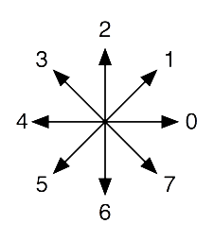
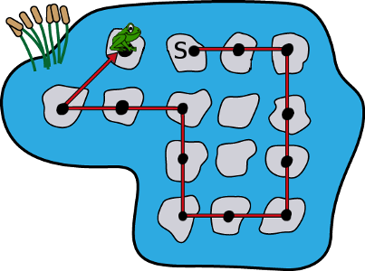
Frog Jump
A frog gets exercise by jumping around a pond. It jumps from lily pad to lily pad in the sequence shown in the picture below. It starts at the lily pad labelled S. It ends on the lily pad as shown (i.e., the frog shown has finished jumping). Each black dot marks a lily pad on which the frog has landed.
The legend below labels each of the 8 possible directions of a jump with an integer from 0 to 7.
What combination of directions did he jump from the start, for example… 0,0,6……..

Slide 10
Frog Jump: Answer
Answer: 0,0,6,6,6,4,4,2,2,4,4,1

Slide 11
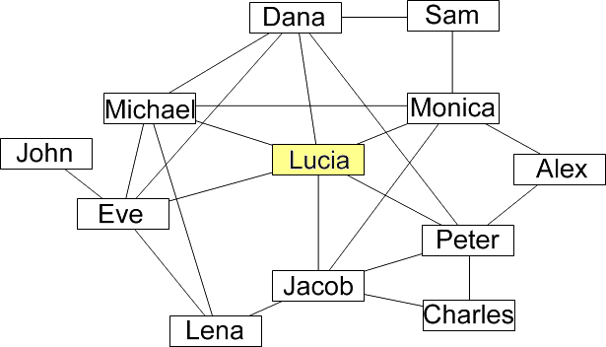
Social Media
Lucia and her friends are part of an on-line social network.
Below is a diagram describing the relationships among Lucia and her friends. Each line indicates a friendship.
Lucia sends a photo to some of her friends.
Each of those friends sends the photo to
all of their friends.
Which of the following groups of friends
can Lucia send her photo to
so that Jacob is not sent the photo?
Notes:
Graphs and Networks are another key form of data representation to help solve problems systematically. The answer is on the next slide.

Slide 12
Social Media: Answer
Answer:
Dana, Michael and Eve
Notes:
The method of solving is every bit as important as the answer : From 1 method, general solutions to similar problems may be found. This is generalisation.

Slide 13
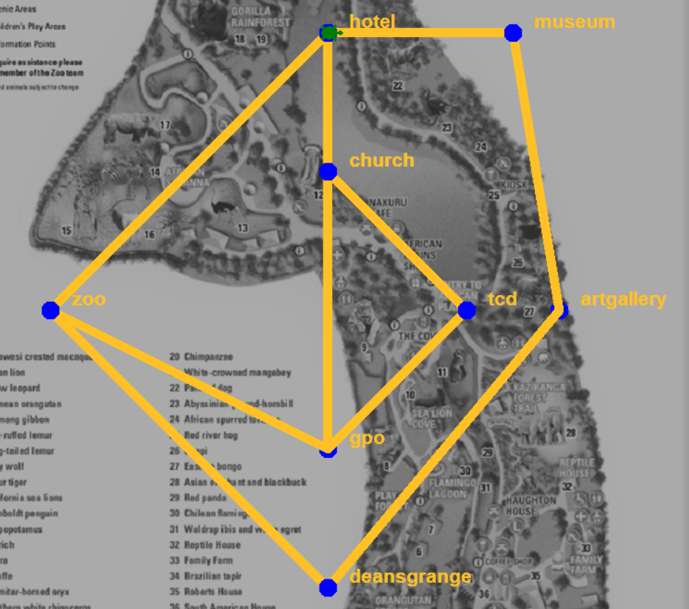
Dublin City Tour Guide
The Tourist Turtle is staying at a hotel in Dublin.
The tour guide (you) wants to take the Turtle to the 7 tourist spots shown (GPO, Zoo, etc…), starting at the hotel and finishing at the hotel.
But the Turtle does not want to visit any site twice!!
You have to map out 2 routes.
Notes:
This is a simplified version of problems involving graphs and nodes. The classic example is the Knight’s Tour.
The Power of Computational Thinking, by Curzon and McOwan, goes into these puzzles in a very systematic and engaging fashion.

Slide 14
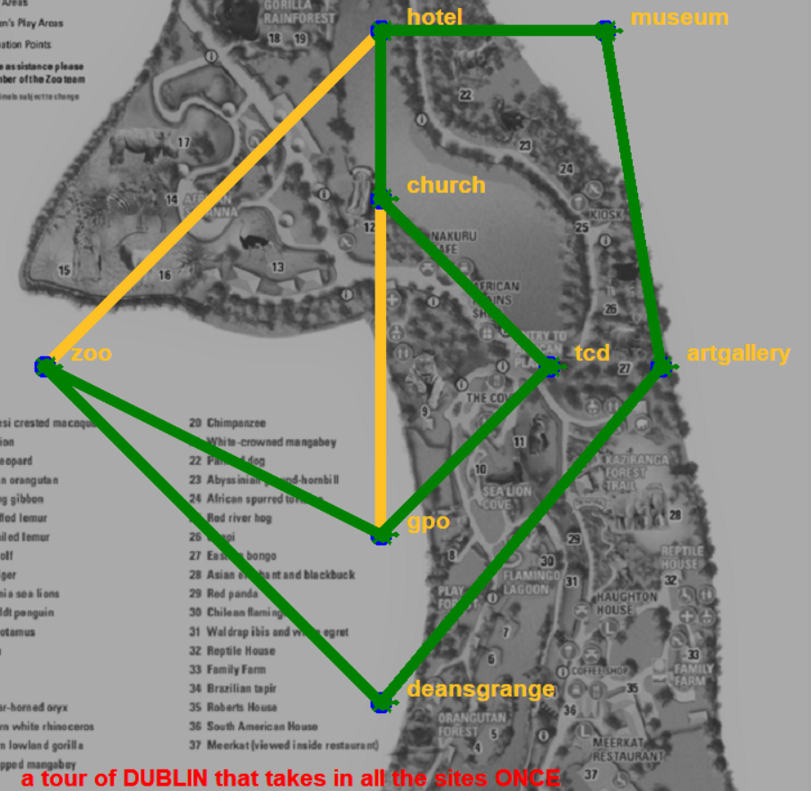
Dublin City Tour Guide – A solution
The Tourist Turtle is staying at a hotel in Dublin.
The tour guide (you) wants to take the Turtle to the 7 tourist spots shown (GPO, Zoo, etc…), starting at the hotel and finishing at the hotel.
One of the routes is shown.
CT Challenge : When you learn more CT techniques, and develop programming skills, can you write a program to solve this, and similar puzzles?
Notes:
On ncca.ie, under Computer Science, a fully worked solution in Python is available for this particular problem.
Visit the Unplugged CT section, for this lesson and also for the Python program….. …. https://www.curriculumonline.ie/Senior-cycle/Senior-Cycle-Subjects/Computer-Science/Support-Material-for-Teaching-and-Learning/1-Computational-Thinking/Unplugged-CT
(The images above is the output of the Python program.)

Slide 15
Boat windows

Slide 16
Boat windows
What is the view through each window of the boat?
LO 1.1 students should be able to describe a systematic process for solving problems and making decisions
Notes:
Encourage groups of 3 to assume roles to solve this problem systematically.
One person should coordinate the other 2. The other 2 should take a different side of the boat and all agree a code to represent clear, tinted, dark.
Ones and Zeroes can work well here.

Slide 17
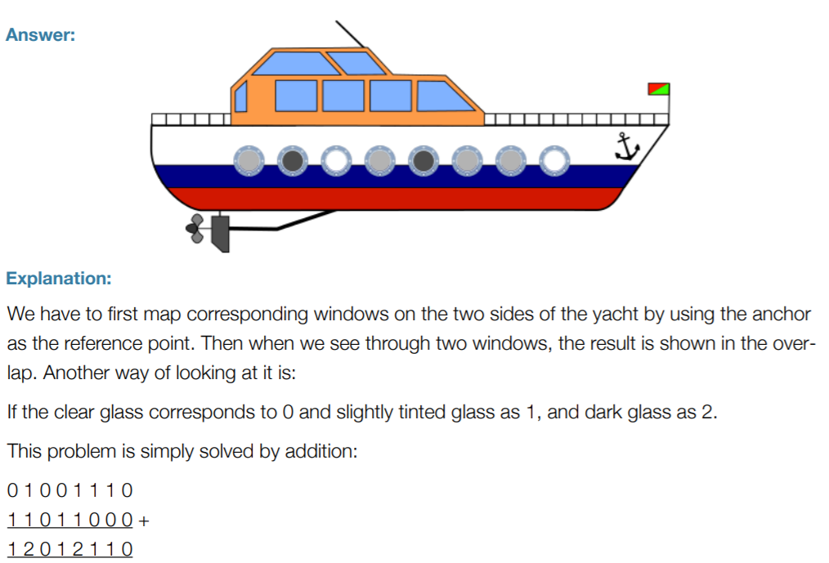
Boat windows: Answers

Slide 18
Ice-cream
LO 2.2 students should be able to use a range of methods for identifying patterns and abstract common features

Slide 19
Ice-cream: Answer

Slide 20
Magical Bracelet

Slide 21
Magical Bracelet: Answer

Slide 22
Dial
Notes:
The process of solving, and thinking how to make a general solution, is key to solving problems in CS.

Slide 23
Dial: Answer

Slide 24
Toothbrushes

Slide 25
Toothbrushes: Answers
LO 1.3 students should be able to solve problems by deconstructing them into smaller units using a systematic approach in an iterative fashion
Notes:
There is a strong sorting theme running through the solution to this puzzle.
There are 2 unplugged lessons on ncca.ie website, in the same section as this resource, (Unplugged CT) detailing unplugged and physically active BUBBLE sort and INSERTION sort algorithms.

Slide 26

Puzzle 1 – Charge my Phone
The beaver family have 3 mobile phones but none of the batteries have any charge.
It takes one hour to fully charge a battery but it does not need to be done all in one go.
The beaver family have only 2 mobile phone charges in their beaver home.
What is the shortest time they need to fully re-charge their phones?
3 hours 2 hours 1.5 hours 1 hour
Notes:
The following 3 puzzles are all very similar in the puzzle content and a systematic solution to the problems.
The answer above is 1.5 hours.

Slide 27
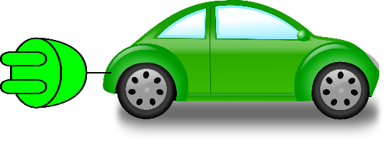
Puzzle 2 – Charge my Car
3 friends decide to go on a trip in their new electric cars.
Their batteries are empty and need to be re-charged.
It takes 3 hours to fully charge the car battery.
The problem is there are only 2 charging points available.
The cars don’t have to be charged all in one go.
How soon can they leave with fully charged batteries?
Notes:
A systematic solution, using a grid, follows puzzle 3.

Slide 28
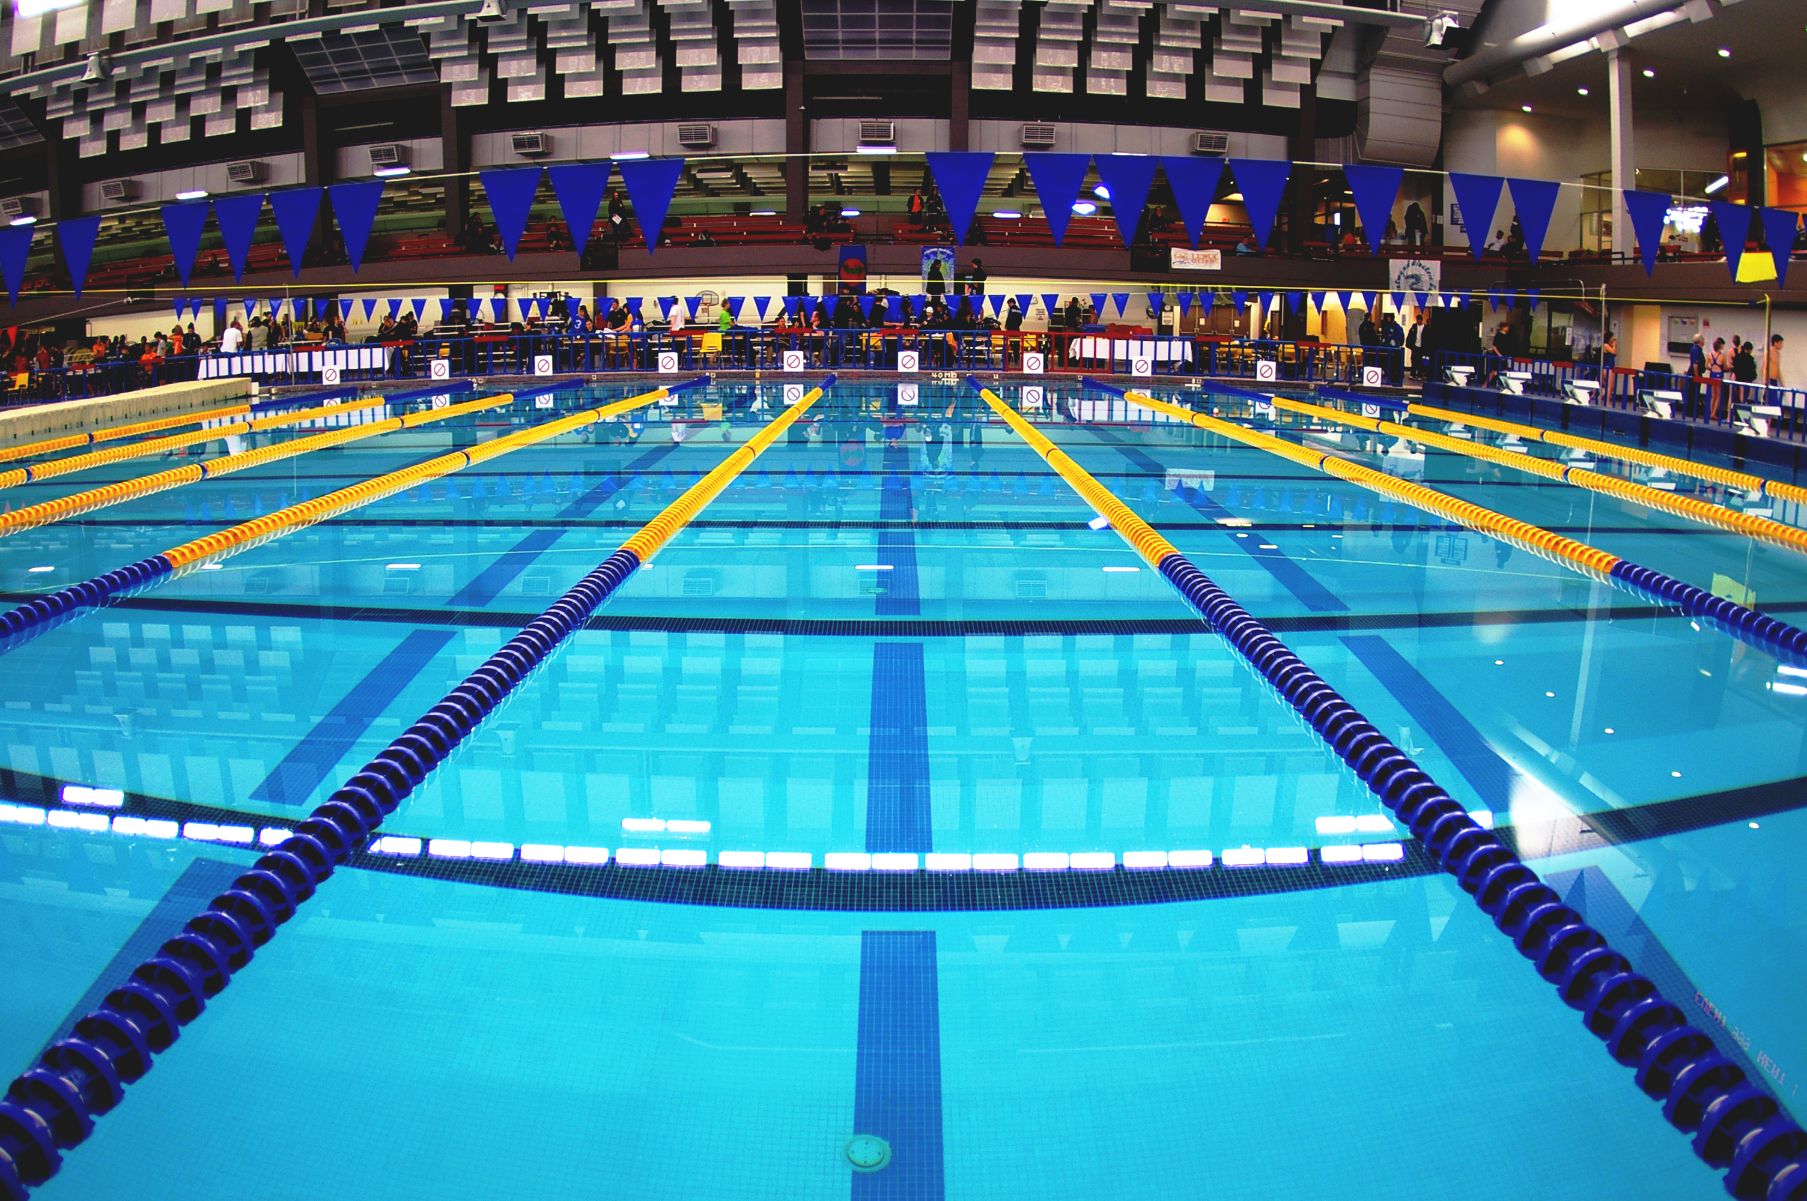
Puzzle 3 – Charge my Swimming Lane
A swimming club using a local swimming pool must be out of the pool by 8am. They have 4 swimmers who need a lane each.
There are only 3 lanes available at any one time and they are charged according to the time in the pool.
Each swimmer needs 2 hours of training, but it does not have to be a continuous 2 hours and can be broken up.
What is the latest time they can start and still ensure all 4 swimmers get their 2 hours training?
Notes:
Students should be encouraged to use CT skills such as Abstraction, Algorithmic Thinking, Logical thinking (even heuristics for some more difficult problems), Data representation using grids or graphs for example, Decomposition, Evaluation, Pattern Recognition, Generalisation and most of all try to be Creative.

Slide 29
Solution to 3 cars with 2 chargers …Puzzle 2
3 HOURS
1.5 HOURS
CAR 1
4.5 HOURS
CAR 2
CAR 3
Notes:
The process of solving, and thinking how to make a general solution, is key to solving problems in CS.

Slide 30
The Great Beaver Escape
Notes:
The process of solving, and thinking how to make a general solution, is key to solving problems in CS.

Slide 31
The Great Beaver Escape
Notes:
The process of solving, and thinking how to make a general solution, is key to solving problems in CS.

Slide 32
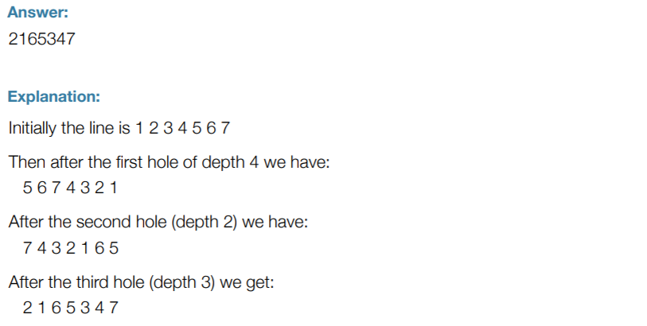
Answer
LO 1.7 students should be able to develop algorithms to implement chosen solutions
Notes:
Students should be encouraged to use CT skills such as Abstraction, Algorithmic Thinking, Logical thinking (even heuristics for some more difficult problems), Data representation using grids or graphs for example, Decomposition, Evaluation, Pattern Recognition, Generalisation and most of all try to be Creative.

Slide 33
Who is married to whom?
Tomás, Davey, Hugh, and Fran are married to Ger, Jane, Sinéad and Bernie, though not necessarily in that order.
Jane, who is Davey’s sister, has five children. Tomás and his partner want to wait a few more years before starting a family.
Tomás has never introduced his wife to Sinéad.
Sinéad works very closely with Davey. Ger is considering telling Davey’s partner that they are working a bit too closely together these days.
Davey and Hugh, by the way, are twin brothers. Who is married to whom?
LO 1.4 students should be able to solve problems using skills of logic
Notes:
Students should be encouraged to use CT skills such as Abstraction, Algorithmic Thinking, Logical thinking (even heuristics for some more difficult problems), Data representation using grids or graphs for example, Decomposition, Evaluation, Pattern Recognition, Generalisation and most of all try to be Creative.

Slide 34
A Solution to who is married to whom?
Ger
Jane
Sinéad
Bernie
Tomas/Sinead info.
Tomás
Davey
Jane/Davey siblings.
Hugh
Jane -5 kids /
Tomas – 0 kids
Fran
?
Sinead/Davey work
Ger not with Davey
Notes:
These first steps, decomposing the information, lead by elimination to Bernie and Davey as partners.
The next step is Davey Hugh Jane are siblings, thus placing an X on the Hugh Jane box. Thus, Jane and Fran are partners.

Slide 35
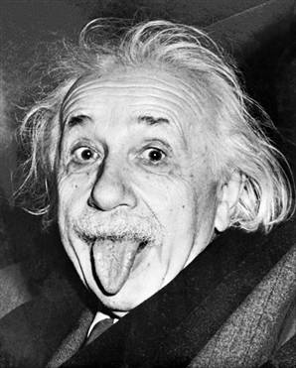
Now try Einstein’s Riddle
Click the image
Use a grid, or some other systematic problem solving technique, to get going on this famous riddle.
Visit www.compsci.ie or NCCA CS for more CT and problem-solving puzzles.
Notes:
Students should be encouraged to use CT skills such as Abstraction, Algorithmic Thinking, Logical thinking (even heuristics for some more difficult problems), Data representation using grids or graphs for example, Decomposition, Evaluation, Pattern Recognition, Generalisation and most of all try to be Creative.

Slide 36
A Famous MIT Puzzle…. Draw continuous lines joining A2A, B2B and C2C, without the lines intersecting.
B
A
C
C
B
A
Notes:
Hint. Join A by going around to the right of C, then through BC, then through AB and joining A.
B follows a similar path to B. A straight line can then join C2C.
Ask students to solve the puzzle as the above algorithm/solution is called out, demonstrating how difficult it can be to give verbal instructions.

Slide 37
A Famous MIT Puzzle…. Draw continuous lines joining A2A, B2B and C2C, without the lines intersecting.
B
A
C
C
B
A
Notes:
Hint. Join A by going around to the right of C, then through the gap between BC, then through AB gap and joining A.
B follows a similar path to B. A straight line can then join C2C.
Ask students to solve the puzzle as the above algorithm/solution is called out, demonstrating how difficult it can be to give verbal instructions.

